Slide 1
Parent Volunteer Training Running Brook Elementary School
HCPSS Confidentiality Training
HCPSS Child Abuse Awareness Training

Slide 5
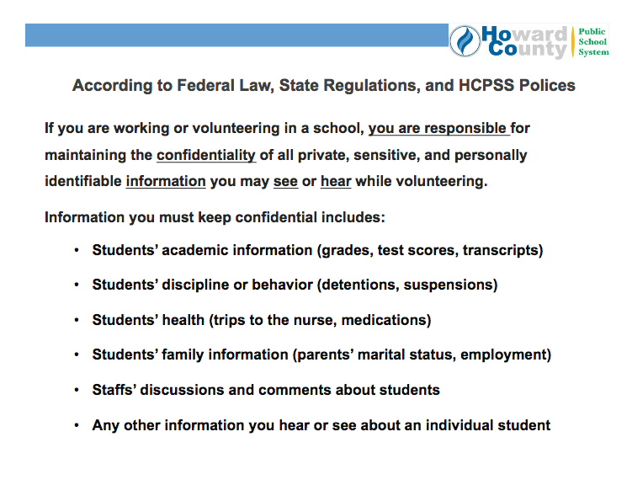

Slide 6
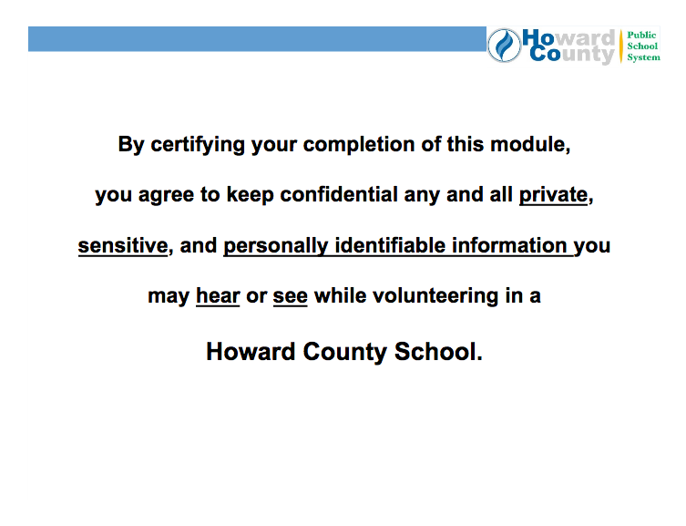

Slide 7
Child Abuse Awareness Training

Slide 9
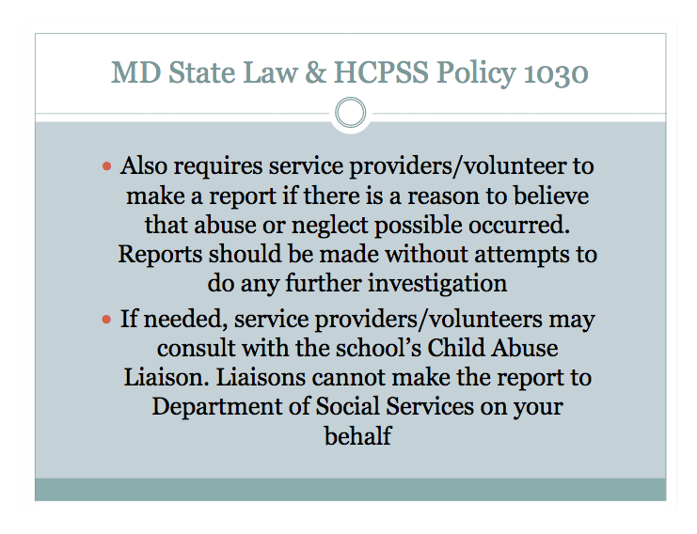

Slide 15
THE HOWARD COUNTY PUBLIC SCHOOL SYSTEM
Certificate of Completion
By signing this form, I certify that:
I have completed the Parent Volunteers and Confidentiality Training
I agree to keep confidential all private, sensitive, and personally identifiable information that I may hear or see while volunteering in a Howard County Public School.
In compliance with HCPSS Policy #1030, I have completed the Child Abuse and Neglect Reporting Procedures Online Training.
_________________________________________ _________________
Printed Name Date
_________________________________________ _________________
Signature School
_____________________________________________________________
Children’s name(s)

